Slide 1
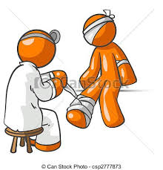
Mechanical Trauma 1
Dr. Nirmala Perera
Senior Lecturer
Dept of Forensic Medicine
University of Kelaniya
2016

Slide 2

Objectives
Be able to
Identify different types of mechanical injuries
Identify causative weapon
Identify circumstances of injuries
Date injuries for medico legal purposes
Identify medico legal significances of injuries
Describe injuries for medico legal purposes

Slide 3
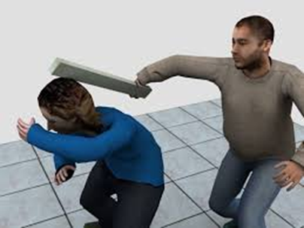
Mechanical injuries
Mechanical injuries (wounds) are injuries produced by physical violence.

Slide 4
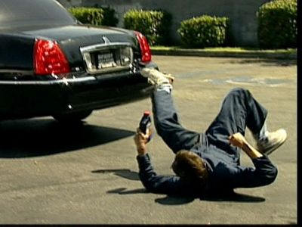
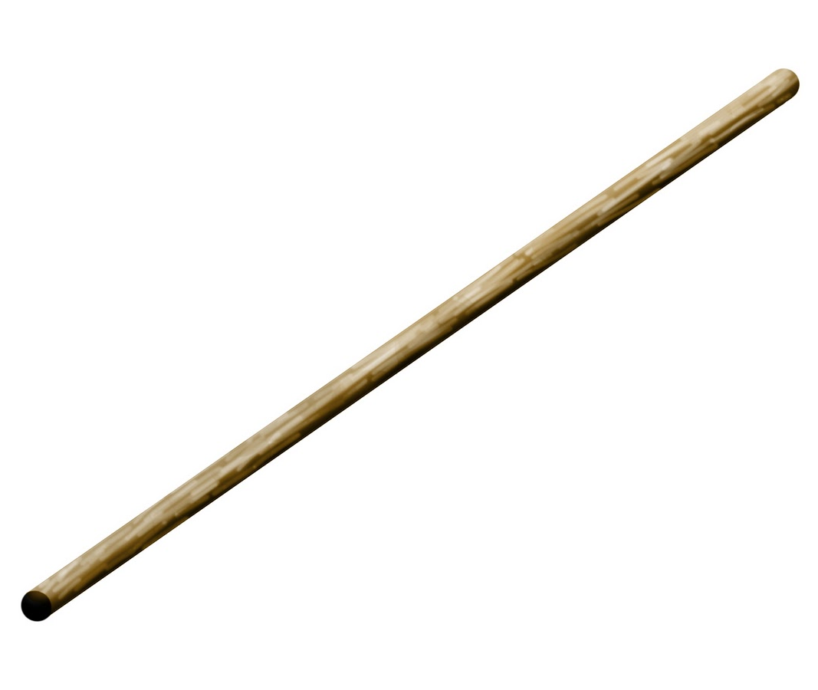
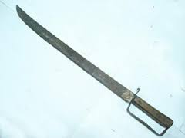
Types of mechanical trauma
Blunt force trauma
Sharp force trauma

Slide 5
Classification of injuries caused by mechanical trauma
Mechanical Trauma
Blunt force trauma
Sharp force trauma
Abrasions
Stab injuries
Contusions
Lacerations
Cut / incised injuries
Fractures

Slide 6

Definitions
Injury
Any harm whatever illegally caused to any person’s body, mind, reputation or property
Ante mortem injuries
Injuries that are caused during life
Post mortem injuries
Injuries that are caused after life

Slide 7
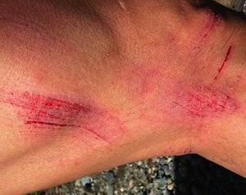
Abrasions
Injury to the epidermal layer of the skin
Superficial, therefore no scaring

Slide 8
Sub types of abrasions
Scratches
Imprint /patterned
Grazes
Friction

Slide 9
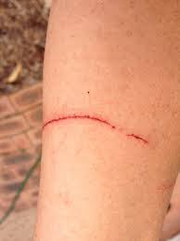
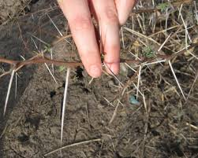
Scratches
Linear abrasions
Caused by pointed objects moving across the skin
Eg: thorn, sand grain, tip of a knife

Slide 10
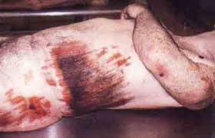
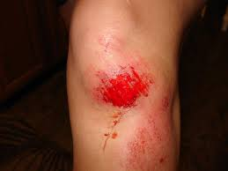
Grazes
Multiple parallel scratch abrasions placed closed to each other
Epidermal tags give direction of blow.

Slide 11
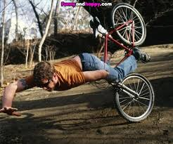
Grazes
There is a tangential movement of a broad rough surface on the skin.
Eg: Road traffic accidents, falls

Slide 12
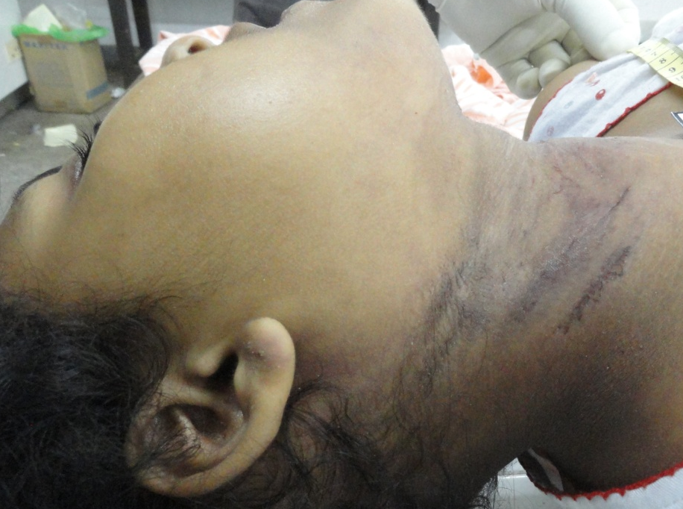
Friction abrasions
Friction abrasions are caused by linear pressure upon the skin with an agent with smooth surface accompanied by movement.
Eg: ligature mark from clothing
11

Slide 13
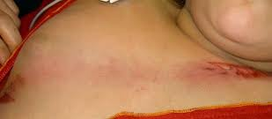
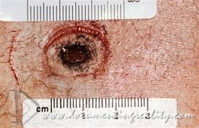
Imprint/patterned abrasions
Imprints are due to the impact of rigid hard rough surface over a localized area without movement.

Slide 14
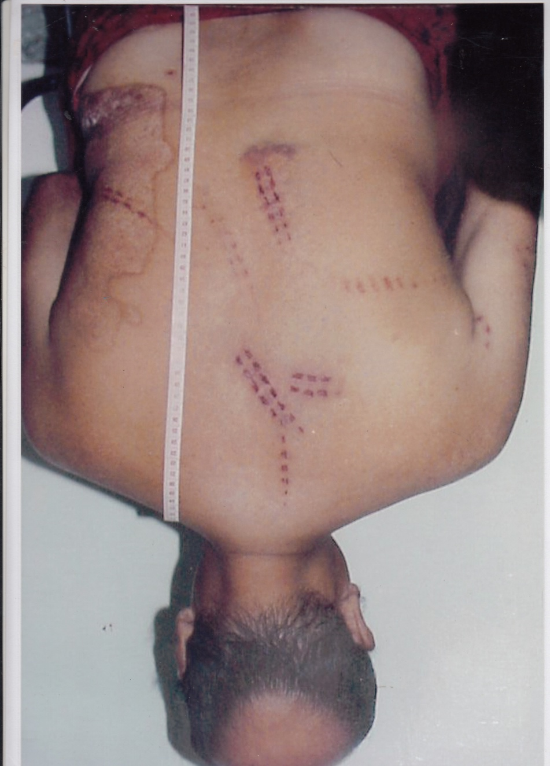
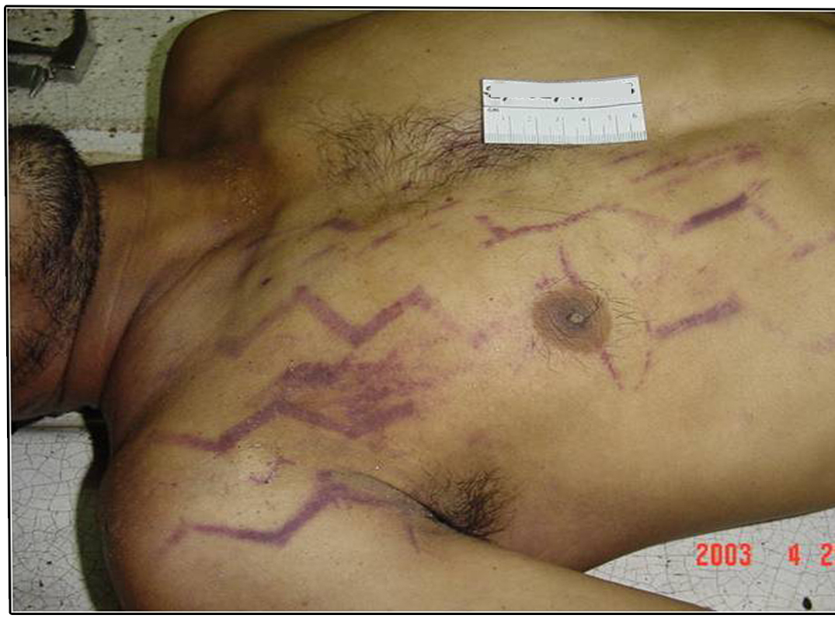
Imprint/patterned abrasions
Examples of imprints abrasions are nail marks, tire marks, cycle chain marks, ligature marks, bite marks

Slide 15
Medico legal significance
Help to identify the shape of the object
Ligature mark
Chain mark
Bite mark

Slide 16
Medico legal significance
Help in reconstructing the event
Nail mark
Tire mark
Hilt mark

Slide 17
Medico legal significance
Abrasions may disappear in
Decomposition
Burns
Immersion

Slide 18
Dating of abrasions
Soon after –
oozing with redness
24 hours –
red flush with a scab
2-4 days –
Red scab
5- 6 days –
Dark scab
7-10 days –
scab falls

Slide 19
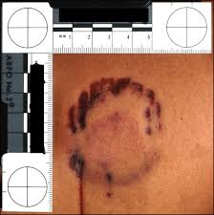
Medico Legal significance of abrasions
14 year old girl is produced for medico legal examination with an alleged history of abuse.
She was bitten, dragged on the floor by her step mother.
On examination there are abrasions on the body.
List the type/s of medico legal information which you can gather during your examination.

Slide 20
Medico Legal significance of abrasions
Identification of causative weapon
Assault vs fall
Reconstruction of event ( relative positions of assailant and victim, direction of drag)
Idea about type of crime ( physical child abuse)
Aging of injury
Compatibility of given history with the examination

Slide 21
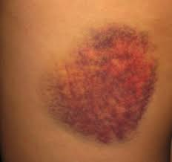
Contusions
A contusion is extravasation, infiltration and coagulation of blood in the tissues following traumatic rupture of capillaries and venules.

Slide 22
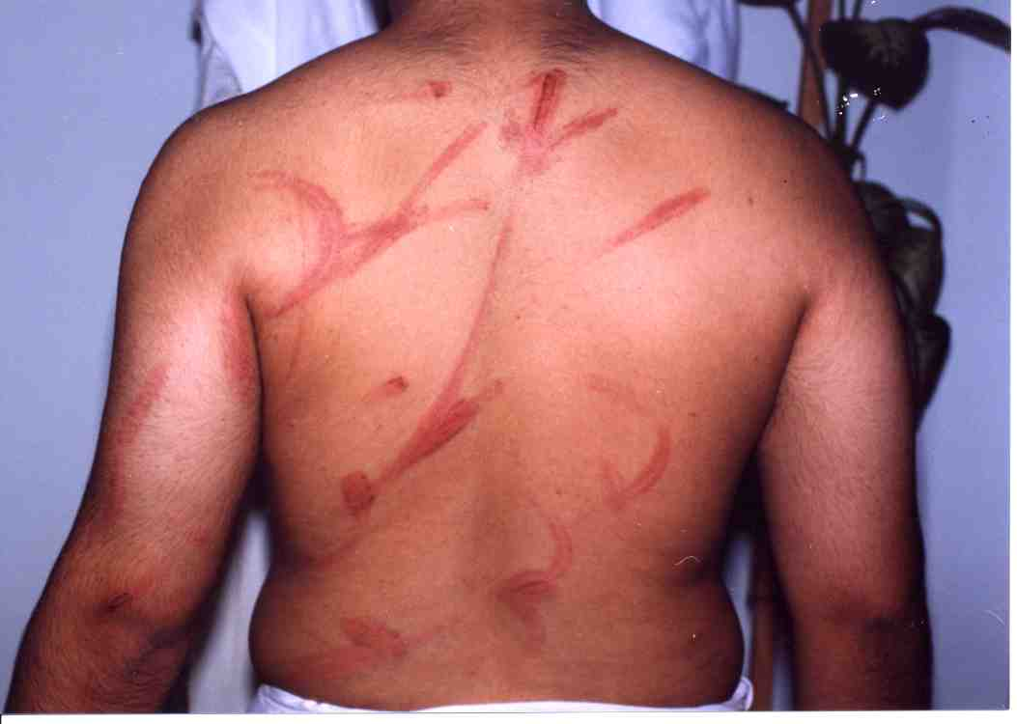
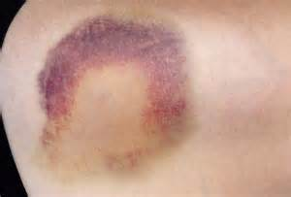
Patterned contusions
Tire mark
Whip mark
Shoe soles
Love bites

Slide 23
Colour change in contusions
Soon after: red
24hrs: blue/purple
48hrs: bluish black
4-5 days: green
7-10 days: yellow

Slide 24
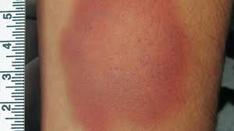
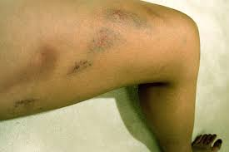
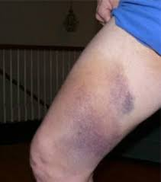
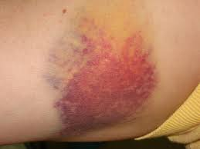
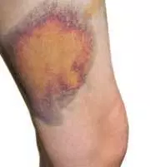
Colour change in contusions

Slide 25
Appearance of the contusion d/o
Complexion of the person
Amount of extravasated blood
Fragility of the vessels
Bleeding and clotting time
Depth of the contusion

Slide 26
Important facts
Deep contusions may appear later
Contusions may appear away from the site of trauma due to gravitation of blood.
Frontal contusions Periorbital area
Upper arm Elbow
Thigh Knee

Slide 27
Important facts
Contusion with collection of blood is referred to as haematoma
Contusions are accentuated in patients with bleeding tendencies.

Slide 28
Shape of the contusion
Finger pulp contusions
Tram line contusions
Suction bruises

Slide 29
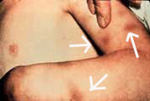
Shape of the contusion
Finger pulp contusions
Smothering, manual strangulation, sexual abuse, child abuse

Slide 30
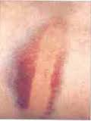
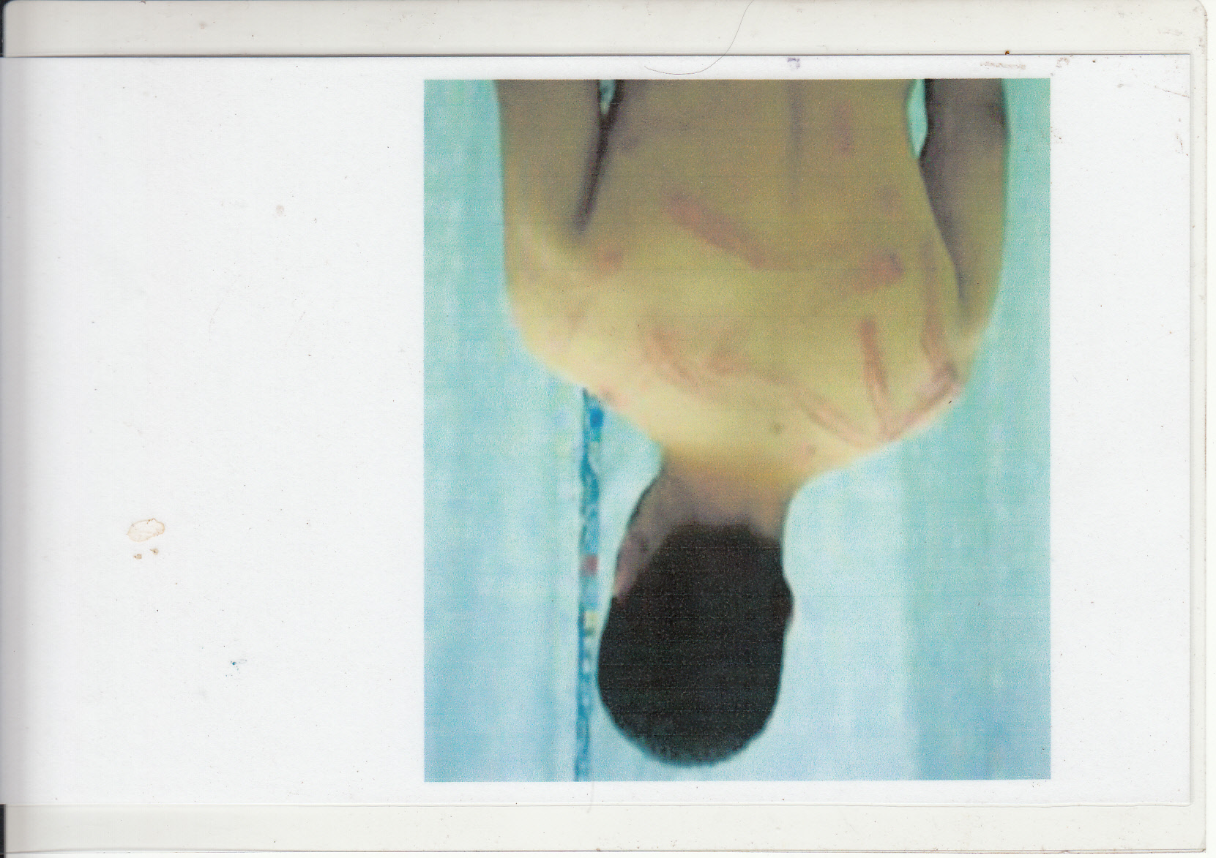
Shape of the contusion
Tram line contusions
Assault with canes, batons, PVC pipes,

Slide 31
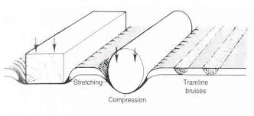
Tram line contusions
These are caused by blunt object with circular or rectangular cross section.
There are two parallel lines width intervening normal skin.
Parallel lines are due to extravasated blood.
Intervening normal skin indicate the width of the weapon.
If it is pliable may encircle the body. (whip)

Slide 32
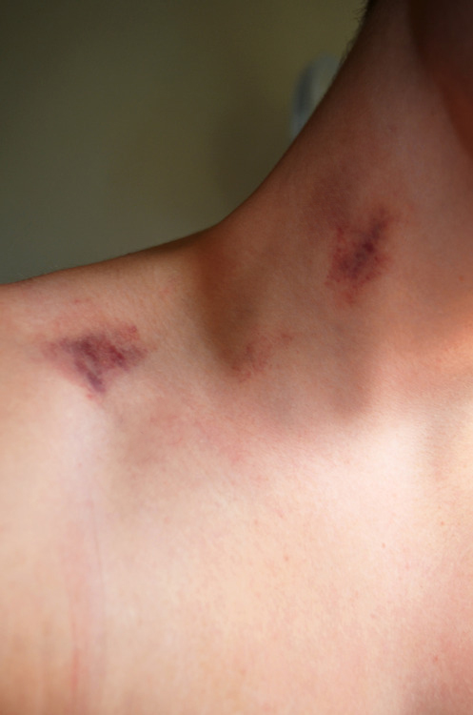
Shape of the contusion
Suction bruises

Slide 33
Post mortem artifacts and contusions
Hypostasis
Princeloo Gordon artifacts
Decomposition

Slide 34
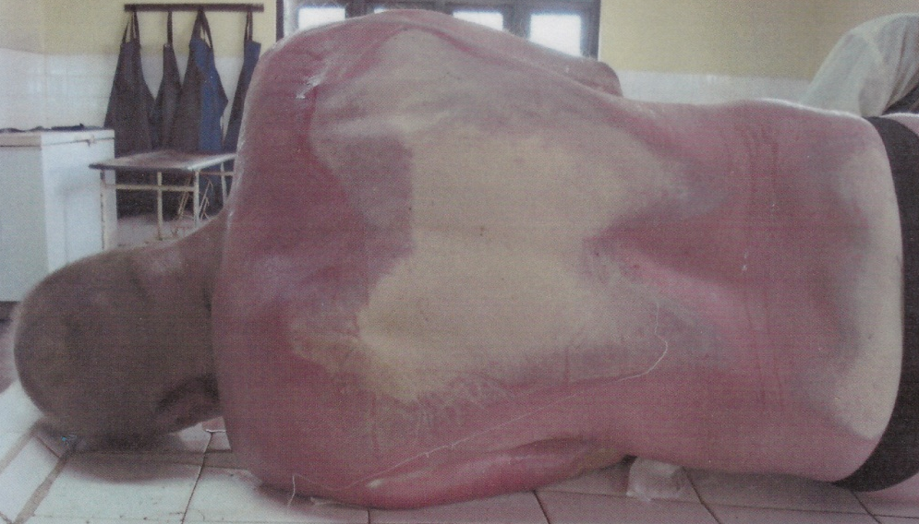
Post mortem artifacts and contusions
Gravitation of blood within the vessels after death.
Hypostasis
Contusion

Slide 35
Contusion vs hypostasis
Hypostasis | Contusion
Seen on most dependant areas | Found on any part of the body
Bilateral and symmetrical | Unilateral, asymmetrical
Blood is within the vessel | Blood is out side the vessel
Easily washed away | Difficult to wash away
Not associated with injuries | Associated with abrasions, lacerations
Blanch on pressure | Does not blanch

Slide 36
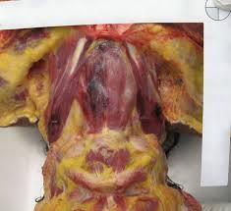
Post mortem artifacts and contusions
Rupture of pharyngo-oesopageal plexus during evisceration
Special neck dissection will minimize the artifact.
Princeloo Gordon artifacts

Slide 37
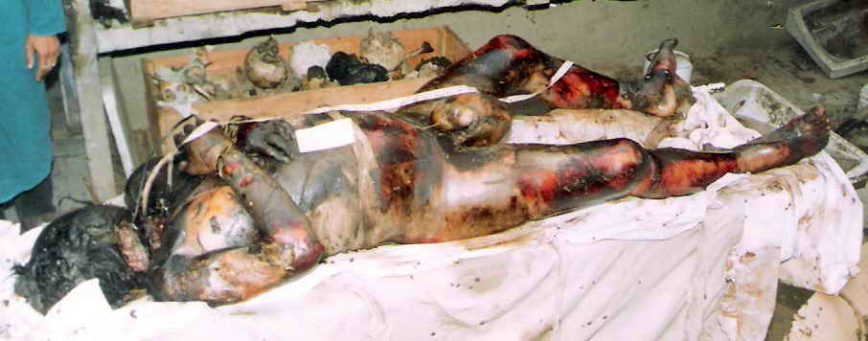
Post mortem artifacts and contusions
Blood inside the vessels will come out staining the tissues.
Decomposition

Slide 38
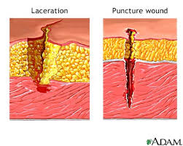
Lacerations
Discontinuity of tissue due to blunt force trauma.
It can be seen on skin, subcutaneous tissue, muscle or any internal organ.

Slide 39
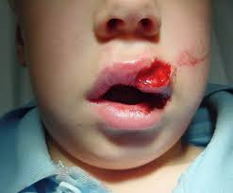
Features of laceration
Has irregular bruised margins
Ends are torn
Foreign matter is present within the injury
Blood vessels torn
Floor is uneven

Slide 40
Types of lacerations
Split lacerations
Torn lacerations
Degloving lacerations
Crush lacerations
Stretch lacerations

Slide 41
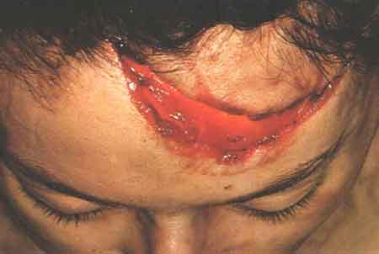
Types of lacerations
Split lacerations
Splitting of the skin due to compression between two hard surfaces ( weapon and bone)
Margins may be regular with minimal contusions

Slide 42
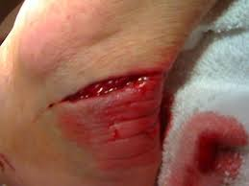
Types of lacerations
Torn lacerations
Projecting object is dragged along the skin tearing the skin
Road traffic accidents and machinery accidents

Slide 43
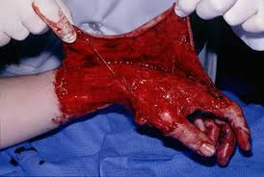
Types of lacerations
Degloving lacerations
Skin get separated from underline tissue due to grinding action
Run over injury

Slide 44
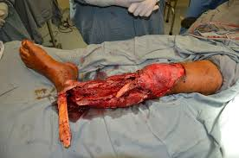
Types of lacerations
Crush lacerations
Crush injury causes fragment of bone to protrude out through the skin
Crush injury to the head or limb

Slide 45
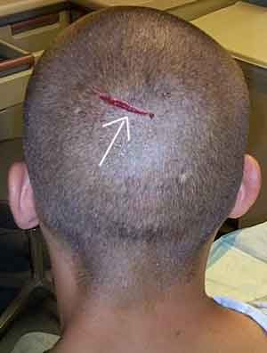
Types of lacerations
Stretch lacerations
Heavy blunt impact on a localized area will cause over stretching of the skin

Slide 46
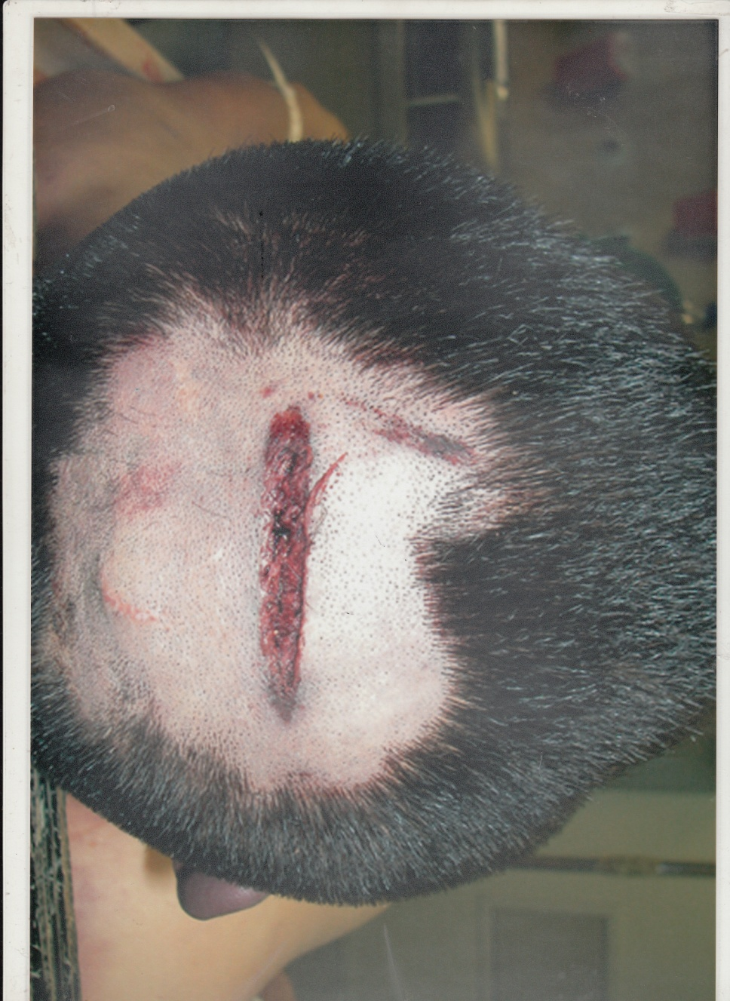
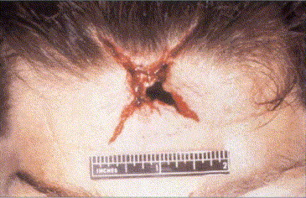
Shape of lacerations
Shape of the laceration indicate the shape of the striking surface.
Stellate
Crescentic
Linear

Slide 47
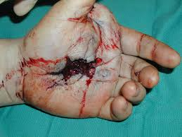
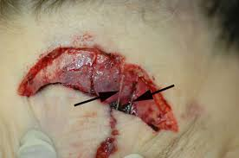
“Lacerations”
These injuries are not pure lacerations as the mechanical trauma is not blunt force.
Perforated lacerations by fire arms
Blast lacerations by expanding gases
Cut lacerations by blunted cutting weapons

Slide 48
Summery
Blunt force trauma
Abrasions
Contusions
Lacerations
Medico legal significances of above injuries

Slide 49
Thank you

Slide 50
